Slide 1
WAN Technologies
WAN TECHNOLOGIES

Slide 2
Technology Options
WAN Technologies
Dial-up
Leased Line
ISDN
X.25
Frame Relay
ATM
DSL
Cable Modem
Microwave Point-to-Point Link
VSAT

Slide 3
Dial-up
WAN Technologies
Uses POTS (Plain Old Telephone System)
Provides a low cost need based access.
Bandwidth 33.6 /56 Kbps.
On the Customer End: Modem is connected to a Telephone Line
On the Service Provider End: Remote Access Server (RAS) is connected to Telephone Lines (33.6 Kbps connectivity) or E1/R2 Line (56 Kbps connectivity)
RAS provide dialin connectivity, authentication and metering.
Achievable bandwidth depends on the line quality.

Slide 4
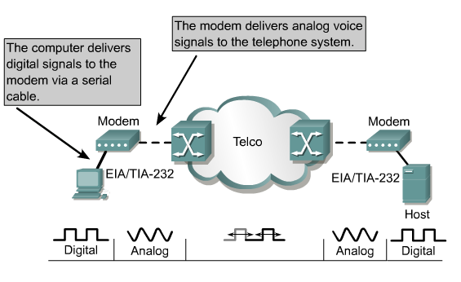
Dial-up
WAN Technologies
How Dial-up Internet Works
1. Hardware:
A modem is required, which converts digital data from a computer into analog signals for the telephone line, and vice-versa.
2. Connection:
The modem dials a phone number to connect to the ISP's server over a conventional telephone line, using an RJ-11 connector.
3. Data Transmission:
Once the connection is established, data is transmitted between the user's computer and the ISP.

Slide 5
Dial-up
WAN Technologies
Key Characteristics
Slow Speed:
Dial-up connections were significantly slower than modern broadband, with speeds measured in kilobits per second (Kbps) rather than megabits per second (Mbps).
Shared Connection:
When you were connected to the Internet, your telephone line was occupied, meaning you couldn't use the phone for voice calls simultaneously.
Distinctive Sounds:
The connection process was characterized by a series of distinctive beeping, hissing, and buzzing noises as the modem negotiated the connection.
Used in the 1990s:
Dial-up was a common form of Internet access in the 1990s, particularly before the widespread adoption of faster technologies like Ethernet.

Slide 6




Dial-up
WAN Technologies
33.6 Kbps
Analog line
Telephone
switch
?
Telephone
switch
Modem
Modem
56 Kbps
Telephone
switch
Access server
Modem
E1

Slide 7
Leased Line
WAN Technologies
Used to provide point-to-point dedicated network connectivity.
Analog leased line can provide maximum bandwidth of 9.6 Kbps.
Digital leased lines can provide bandwidths :
64 Kbps, 2 Mbps (E1), 8 Mbps (E2), 34 Mbps (E3) ...

Slide 8
Leased Line
WAN Technologies
Key Characteristics
Dedicated Bandwidth:
Unlike shared broadband, a leased line dedicates the full bandwidth to a single business, guaranteeing the speeds you pay for.
Symmetrical Speeds:
Upload and download speeds are equal, which is crucial for data-intensive applications.
Guaranteed Uptime:
A Service Level Agreement (SLA) provides guarantees for the connection's quality, availability, and performance.
Low Latency and High Bandwidth:
The direct, private link minimizes signal interruption and provides fast, reliable data transfer.
Private & Secure:
The connection is exclusive to your business, offering enhanced privacy and protection from network interference.

Slide 9
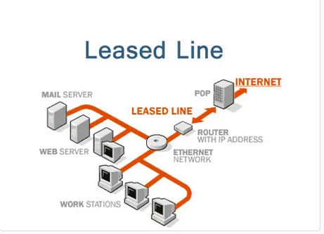
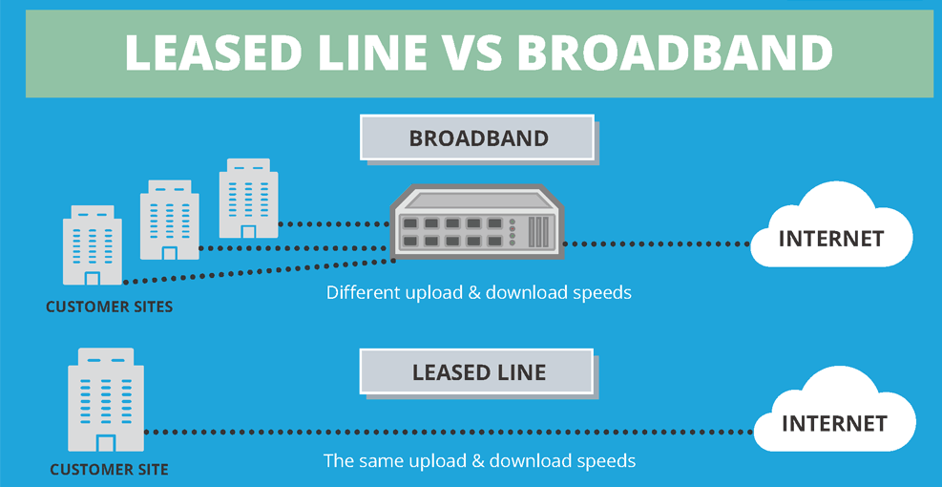
Leased Line Internet Connectivity
WAN Technologies

Slide 10
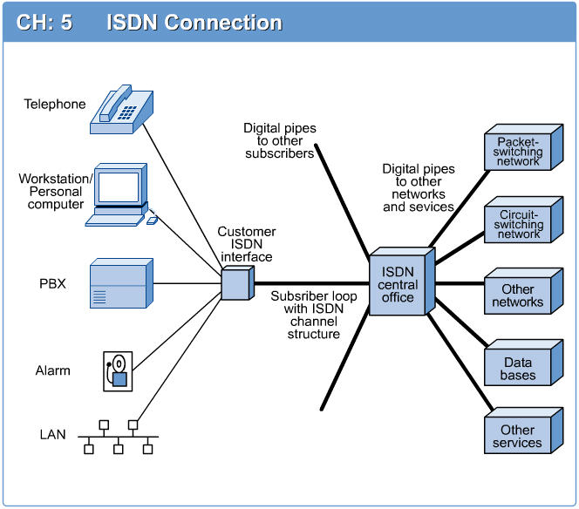
ISDN
WAN Technologies
Another alternative to using analog telephones lines to establish a connection is ISDN.
Speed is one advantage ISDN has over telephone line connections.
ISDN network is a switched digital network consisting of ISDN Switches.
Each node in the network is identified by hierarchical ISDN address which is of 15 digits.
ISDN user accesses network through a set of standard interfaces provided by ISDN User Interfaces.

Slide 11
ISDN
Digital Transmission:
ISDN uses digital signals instead of analog signals, allowing for more information to be transmitted and maintained at higher quality over longer distances.
Integrated Services:
It integrates various communication services, such as voice calls, fax, and data, into a single digital network.
Higher Bandwidth:
ISDN provides higher bandwidth than traditional modems, enabling faster data speeds, with common internet access speeds reaching up to 128 kbit/s.
Channel Bonding:
Users could bond multiple channels (typically 64 kbit/s) to achieve even greater data rates for demanding applications.

Slide 12
ISDN
Simultaneous Services:
ISDN allows for simultaneous use of voice and data services over the same line, a significant improvement over analog connections.
Faster Dial-up Internet:
For Internet access, ISDN offered a faster and more reliable "dial-up" connection compared to traditional dial-up modems.
Specialized Business Use:
While largely replaced by broadband, ISDN was used for business applications, including as a backup for dedicated lines or in areas where broadband was not available.

Slide 13
ISDN
WAN Technologies
Two types of user access are defined
  Basic Access - Consists of two 64Kbps user channels (B channel) and one 16Kbps signally channel (D channel) providing service at 144 Kbps.
  Primary access - Consists of thirty 64Kbps user channels (B channels) and a 64 Kbps signally channel (D channel) providing service at 2.048Mbps (One 64 Kbps channel is used for Framing and Synchronization).
B
B
D
Information 128 Kbps
(Voice & Data)
Signaling 16Kbps
Basic
B
B
D
Information 1920 Kbps
Voice & Data
Signaling 64 Kbps
Primary

Slide 14
